Slide 1
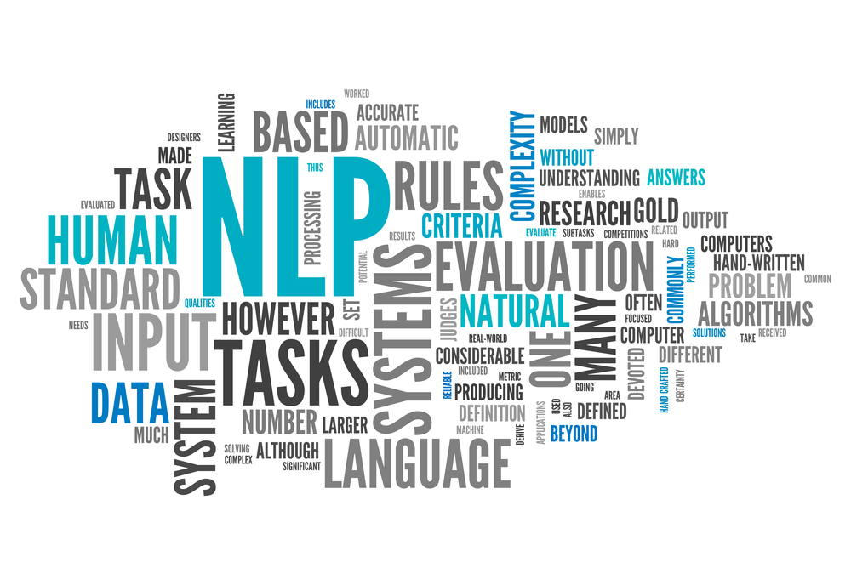
Natural Language Processing (NLP) is a crucial field within artificial intelligence that focuses on enabling computers to comprehend, interpret, and generate human language. By leveraging NLP, computers can bridge the gap between human communication and machine understanding, making interactions with technology more intuitive and seamless.The importance of NLP in modern AI applications cannot be overstated. It underpins a wide range of technologies that we use daily, from voice-activated assistants like Siri and Alexa to automated translation services such as Google Translate. In addition, NLP is essential in analyzing large volumes of text data, making it indispensable in industries like customer service, healthcare, and finance.NLP encompasses a variety of tasks that contribute to its broad applicability. These tasks include sentiment analysis, which identifies and extracts subjective information from text, such as emotions or opinions. Machine translation is another key area, allowing text to be translated from one language to another with increasing accuracy. Speech recognition transcribes spoken language into text, enabling applications like voice typing and virtual assistants. Finally, text generation is a growing field where models create coherent and contextually appropriate text, facilitating tasks like content creation and automated report writing.

Slide 2
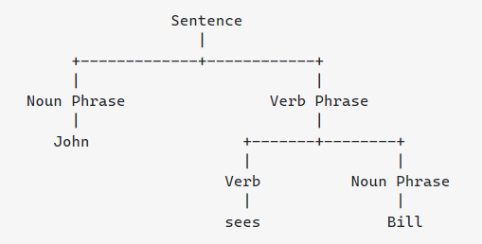
Natural Language Processing relies on several key techniques to process and understand human language effectively. These foundational methods are essential for breaking down and analyzing the complexities of language.
Tokenization is one of the first steps in NLP, where text is divided into smaller units like words or phrases. This process helps the computer identify and manage linguistic elements more efficiently. Part-of-speech (POS) tagging assigns labels to each word in a sentence, indicating its grammatical role, such as noun, verb, or adjective. This tagging is crucial for understanding sentence structure and meaning.
Named Entity Recognition (NER) is another important technique, where the model identifies and classifies entities in the text, such as people, organizations, dates, and locations. NER is widely used in information extraction and organizing unstructured data. Dependency parsing goes a step further by analyzing the grammatical structure of a sentence, identifying relationships between words, and constructing a parse tree that represents these dependencies.

Slide 3
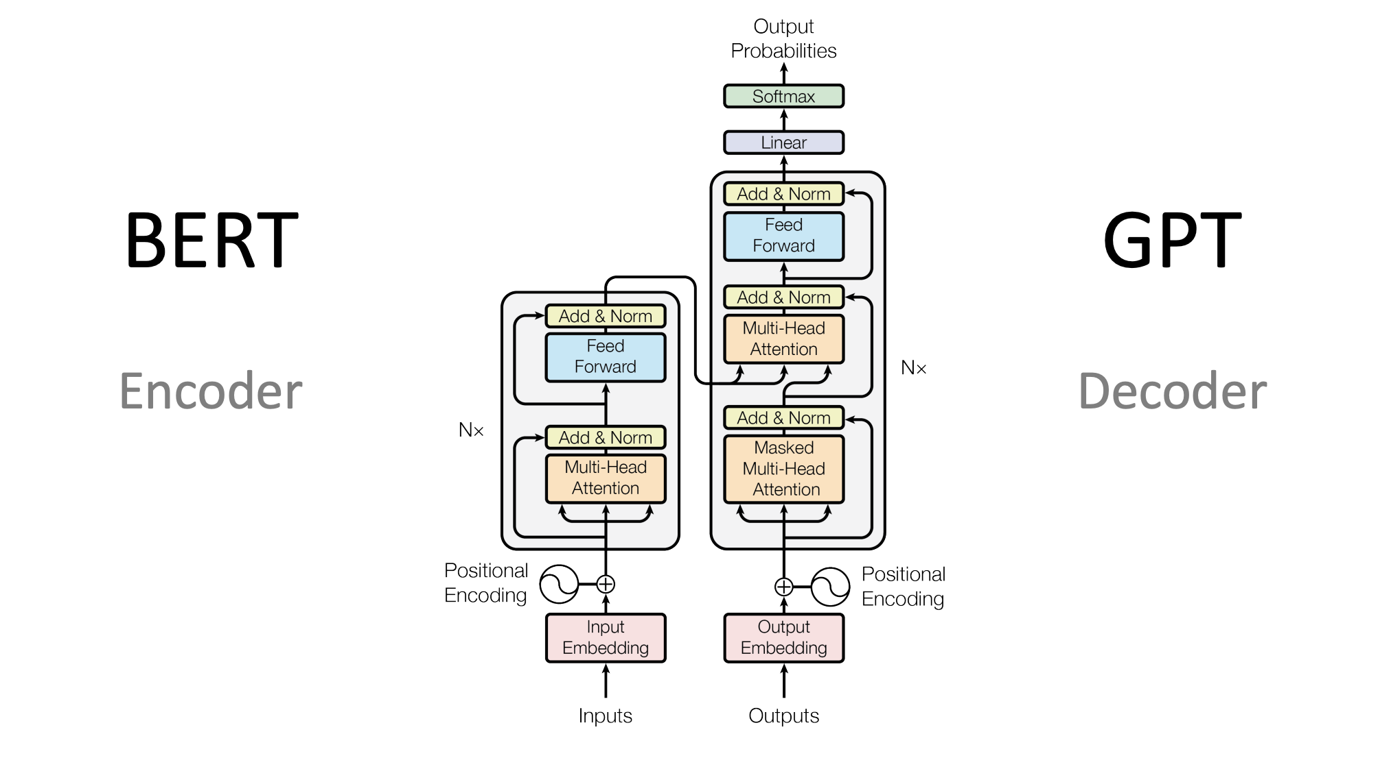
The development of advanced models and architectures has propelled NLP to new heights, enabling more accurate and sophisticated language understanding. Traditional models, like n-grams and Hidden Markov Models (HMMs), laid the groundwork for NLP but were limited in their ability to capture long-range dependencies and context in text.
The advent of neural networks and deep learning has revolutionized NLP, with models like Long Short-Term Memory (LSTM) networks and Transformer-based models leading the charge. LSTMs are a type of recurrent neural network (RNN) that excel at handling sequential data, making them ideal for tasks like language modeling and machine translation. However, they have largely been surpassed by Transformer-based models, such as BERT (Bidirectional Encoder Representations from Transformers) and GPT (Generative Pre-trained Transformer).
Transformers have become the backbone of modern NLP due to their ability to process text in parallel and capture context from both directions of a sentence. BERT, for example, is a pre-trained model that understands context by looking at words in relation to each other in both directions. GPT, on the other hand, is used for text generation, where it predicts the next word in a sequence based on the context provided by previous words.

Slide 4

The future of Natural Language Processing is filled with exciting possibilities as researchers and developers continue to push the boundaries of what these models can achieve. One key area of focus is improving the efficiency and accuracy of NLP models, particularly in resource-constrained environments. As models become more compact and optimized, they will be able to run on a wider range of devices, making NLP applications more accessible.
Real-time language translation is another promising area, where the goal is to enable seamless communication between speakers of different languages with minimal delay. Advances in understanding context and emotion will also enhance the capabilities of NLP models, allowing for more natural and meaningful interactions with machines.
Finally, the integration of NLP with other AI fields, such as computer vision and robotics, will lead to more sophisticated and versatile systems. For example, combining NLP with computer vision can enable machines to interpret and respond to multimodal inputs, such as analyzing text within images or understanding commands in a visual context.

